Slide 1
The Hour of Glory
2024 Quarter 4 Lesson 12
John 18, 19, 20

Slide 2




Slide 3

Is it TRUE?
Consistently implementing a good self-care routine takes some thought and effort, so be on the look-out for small opportunities to integrate the practice into everyday life. Take out your calendar and put your self-care activities on your schedule and make them a priority. The more you can incorporate it into your routine, the better you’ll feel!

Slide 4
Is it TRUE?
15 We then that are strong ought to bear the infirmities of the weak, and not to please ourselves.
² Let every one of us please his neighbour for his good to edification.
Romans 15:1-5

Slide 5
Is it TRUE?
³ For even Christ pleased not himself; but, as it is written, The reproaches of them that reproached thee fell on me.
Romans 15:3-5

Slide 6
Is it TRUE?
⁴ For whatsoever things were written aforetime were written for our learning, that we through patience and comfort of the scriptures might have hope.
Romans 15:4-5

Slide 7
Is it TRUE?
⁵ Now the God of patience and consolation grant you to be likeminded one toward another according to Christ Jesus:
Romans 15:5

Slide 8
Is it TRUE?
¹³ Now the God of hope fill you with all joy and peace in believing, that ye may abound in hope, through the power of the Holy Ghost.
Romans 15:13

Slide 9
Is it TRUE?
³ Trust in the Lord, and do good; so shalt thou dwell in the land, and verily thou shalt be fed.
⁴ Delight thyself also in the Lord: and he shall give thee the desires of thine heart.
Psalm 37:3-4

Slide 10
Our Example: Glorified!
²³ And Jesus answered them, saying, The hour is come, that the Son of man should be glorified.
John 12:23-26

Slide 11
Our Example: Glorified!
²⁴ Verily, verily, I say unto you, Except a corn of wheat fall into the ground and die, it abideth alone: but if it die, it bringeth forth much fruit.
John 12:23-26

Slide 12
Our Example: Glorified!
²⁵ He that loveth his life shall lose it; and he that hateth his life in this world shall keep it unto life eternal.
John 12:23-26

Slide 13
Our Example: Glorified!
²⁶ If any man serve me, let him follow me; and where I am, there shall also my servant be: if any man serve me, him will my Father honour.
John 12:23-26

Slide 14
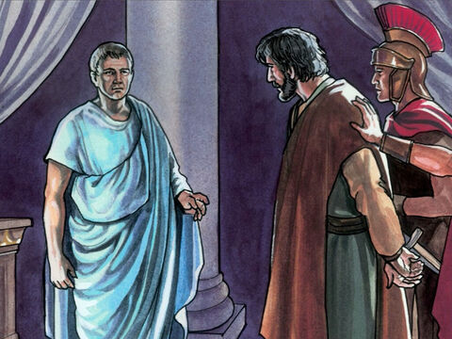
Claims of Glory- John 18:33
Then Pilate entered into the judgment hall again, and called Jesus, and said unto him, Art thou the King of the Jews?

Slide 15
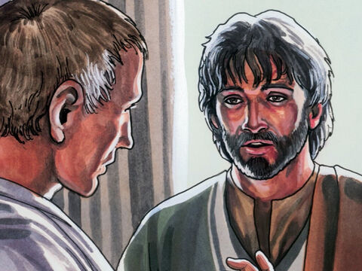
Claims of Glory - John 18:34
Jesus answered him, Sayest thou this thing of thyself, or did others tell it thee of me?

Slide 16
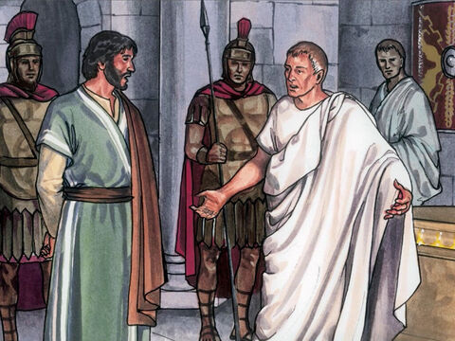
Claims of Glory - John 18:35
Pilate answered, Am I a Jew? Thine own nation and the chief priests have delivered thee unto me: what hast thou done?

Slide 17
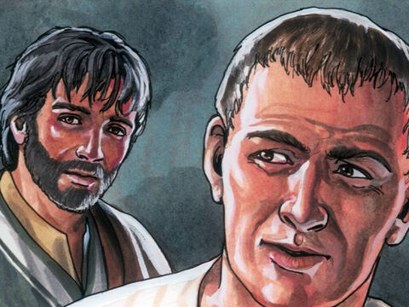
Claims of Glory - John 18:36
Jesus answered, My kingdom is not of this world: if my kingdom were of this world, then would my servants fight, that I should not be delivered to the Jews: but now is my kingdom not from hence.

Slide 18
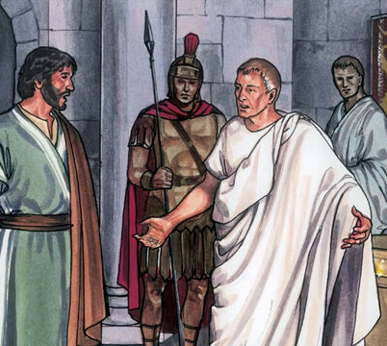
Claims of Glory - John 18:37
Pilate therefore said unto him, Art thou a king then? Jesus answered, Thou sayest that I am a king. To this end was I born, and for this cause came I into the world, that I should bear witness unto the truth. Every one that is of the truth heareth my voice.

Slide 19
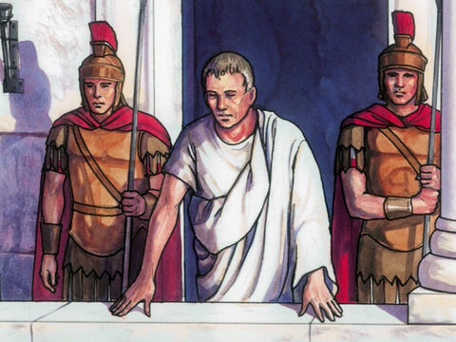
Claims of Glory - John 18:38
Pilate saith unto him, What is truth? And when he had said this, he went out again unto the Jews, and saith unto them, I find in him no fault at all.

Slide 20
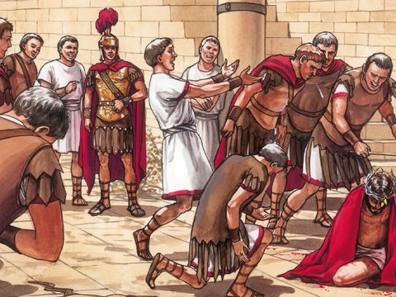
Mockery and Glory
John 19:1
19 Then Pilate therefore took Jesus, and scourged him.

Slide 21
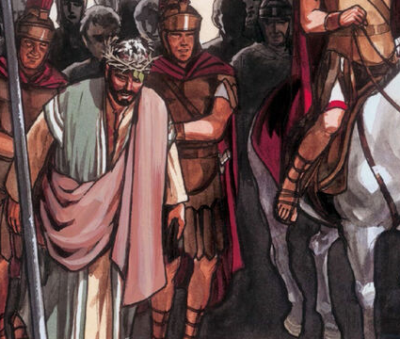
Mockery and Glory
John 19:2
² And the soldiers platted a crown of thorns, and put it on his head, and they put on him a purple robe,

Slide 22
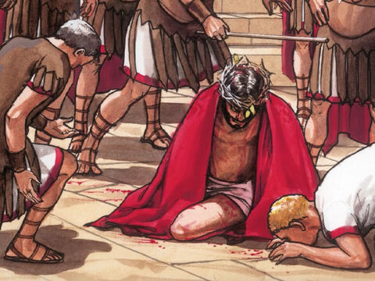
Mockery and Glory
John 19:3
³ And said, Hail, King of the Jews! and they smote him with their hands.

Slide 23
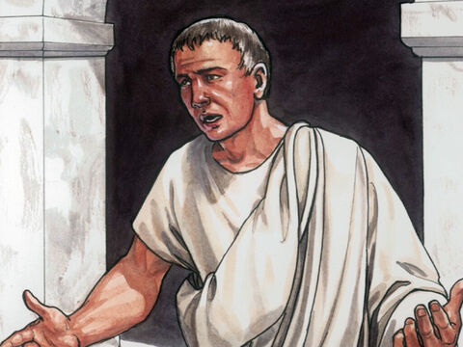
Truth and Glory - John 19:4
Pilate therefore went forth again, and saith unto them, Behold, I bring him forth to you, that ye may know that I find no fault in him.

Slide 24
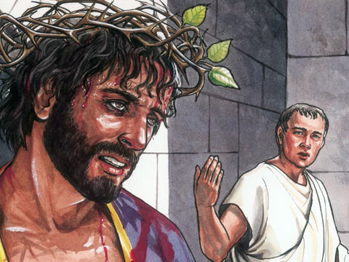
Mockery and Glory
John 19:5
Then came Jesus forth, wearing the crown of thorns, and the purple robe. And Pilate saith unto them, Behold the man!

Slide 25
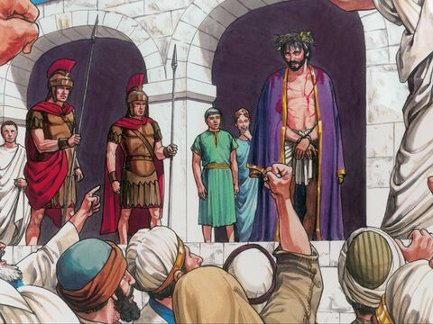
Mockery and Glory
John 19:6
When the chief priests therefore and officers saw him, they cried out, saying, Crucify him, crucify him. Pilate saith unto them, Take ye him, and crucify him: for I find no fault in him.

Slide 26
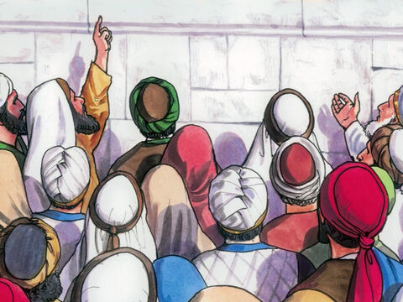
Fear and Glory - John 19:7
The Jews answered him, We have a law, and by our law he ought to die, because he made himself the Son of God.

Slide 27
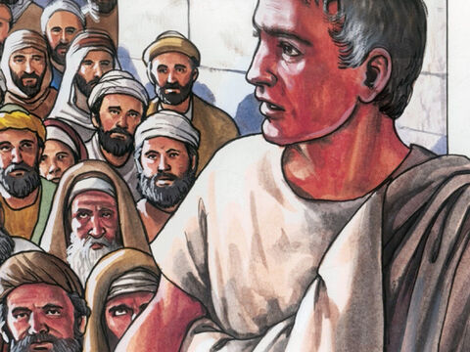
Fear and Glory - John 19:8
When Pilate therefore heard that saying, he was the more afraid;

Slide 28
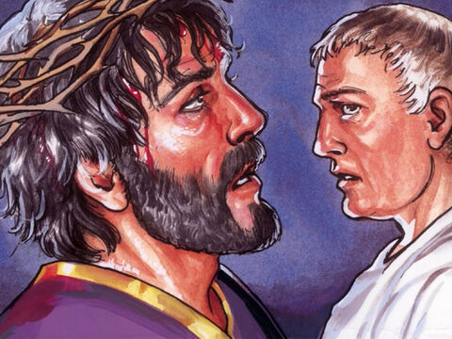
Fear and Glory - John 19:9
And went again into the judgment hall, and saith unto Jesus, Whence art thou? But Jesus gave him no answer.

Slide 29
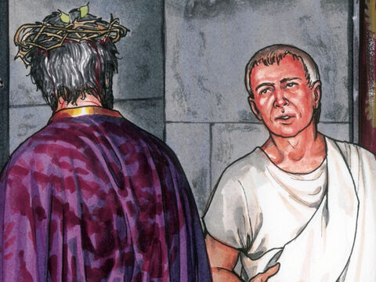
Fear and Glory - John 19:10
Then saith Pilate unto him, Speakest thou not unto me? knowest thou not that I have power to crucify thee, and have power to release thee?

Slide 30
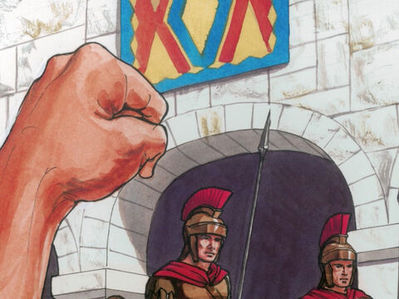
Fear and Glory - John 19:11
Jesus answered, Thou couldest have no power at all against me, except it were given thee from above: therefore he that delivered me unto thee hath the greater sin.

Slide 31
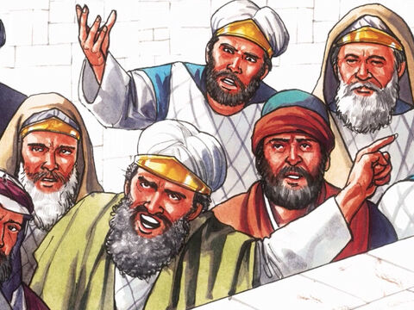
Fear and Glory - John 19:12
And from thenceforth Pilate sought to release him: but the Jews cried out, saying, If thou let this man go, thou art not Caesar's friend: whosoever maketh himself a king speaketh against Caesar.

Slide 32
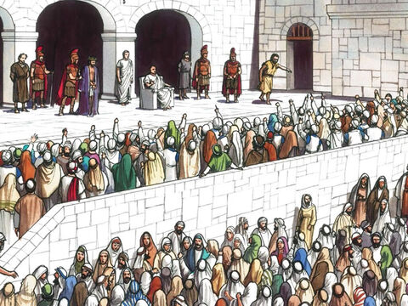
Fear and Glory - John 19:13
When Pilate therefore heard that saying, he brought Jesus forth, and sat down in the judgment seat in a place that is called the Pavement, but in the Hebrew, Gabbatha.

Slide 33
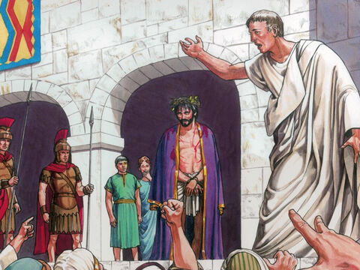
Kingship and Glory
John 19:14
And it was the preparation of the passover, and about the sixth hour: and he saith unto the Jews, Behold your King!

Slide 34
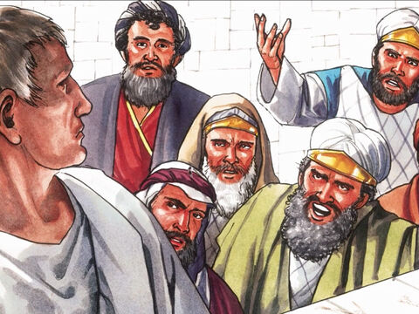
Kingship and Glory
John 19:15
But they cried out, Away with him, away with him, crucify him. Pilate saith unto them, Shall I crucify your King? The chief priests answered, We have no king but Caesar.

Slide 35
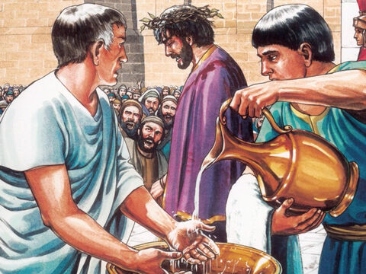
Kingship and Glory
John 19:16
Then delivered he him therefore unto them to be crucified. And they took Jesus, and led him away.

Slide 36
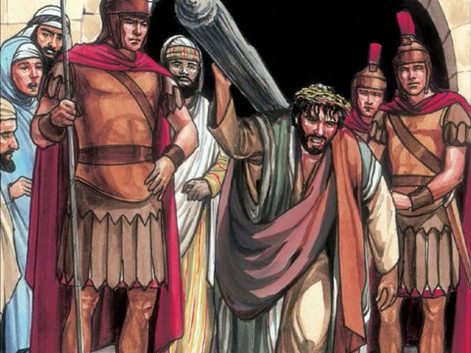
Kingship and Glory
John 19:17
¹⁷ And he bearing his cross went forth into a place called the place of a skull, which is called in the Hebrew Golgotha:

Slide 37
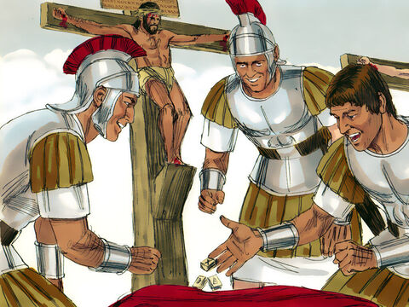
Kingship and Glory
John 19:18
¹⁸ Where they crucified him, and two other with him, on either side one, and Jesus in the midst.

Slide 38
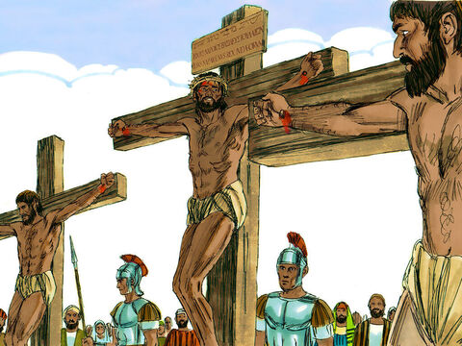
Kingship and Glory
John 19:19
¹⁹ And Pilate wrote a title, and put it on the cross. And the writing was Jesus Of Nazareth The King Of The Jews.

Slide 39
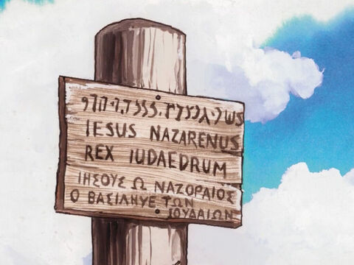
Kingship and Glory
John 19:20
²⁰ This title then read many of the Jews: for the place where Jesus was crucified was nigh to the city: and it was written in Hebrew, and Greek, and Latin.

Slide 40
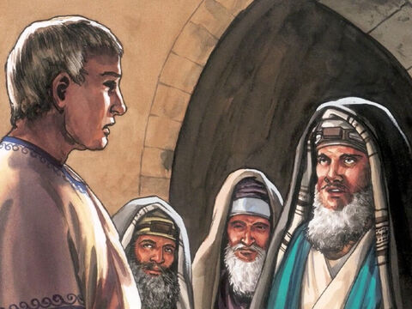
Kingship and Glory
John 19:21
²¹ Then said the chief priests of the Jews to Pilate, Write not, The King of the Jews; but that he said, I am King of the Jews.

Slide 41
Kingship and Glory
John 19:22
²² Pilate answered, What I have written I have written.

Slide 42
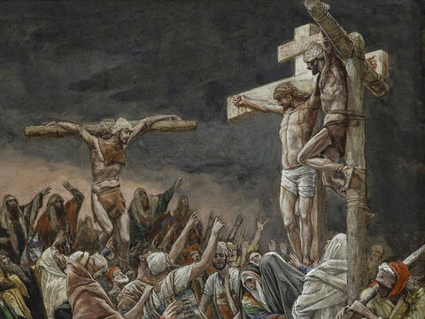
The Triumph of Glory
John 19:28
²⁸ After this, Jesus knowing that all things were now accomplished, that the scripture might be fulfilled, saith, I thirst.

Slide 43
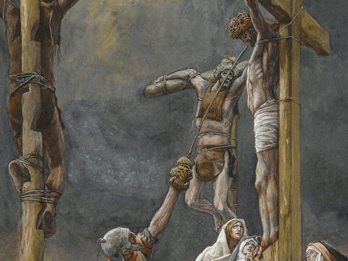
The Triumph of Glory
John 19:29
²⁹ Now there was set a vessel full of vinegar: and they filled a spunge with vinegar, and put it upon hyssop, and put it to his mouth.

Slide 44
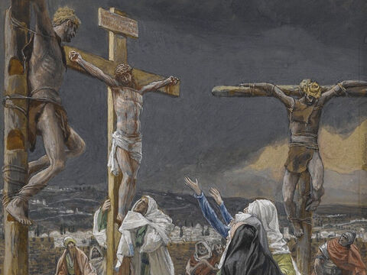
The Triumph of Glory
John 19:30
³⁰ When Jesus therefore had received the vinegar, he said, It is finished: and he bowed his head, and gave up the ghost.

Slide 45
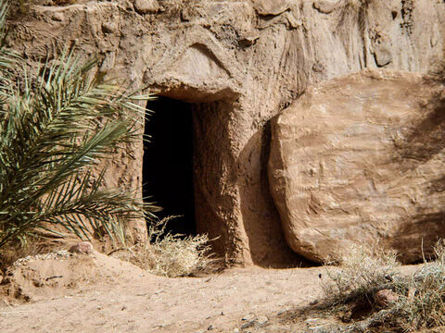
Revealed Glory- John 20:1
The first day of the week cometh Mary Magdalene early, when it was yet dark, unto the sepulchre, and seeth the stone taken away from the sepulchre.

Slide 46
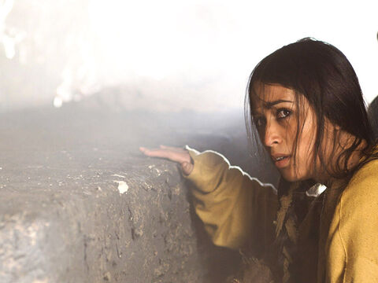
Revealed Glory - John 20:2
Then she runneth, and cometh to Simon Peter, and to the other disciple, whom Jesus loved, and saith unto them, They have taken away the Lord out of the sepulchre, and we know not where they have laid him.

Slide 47
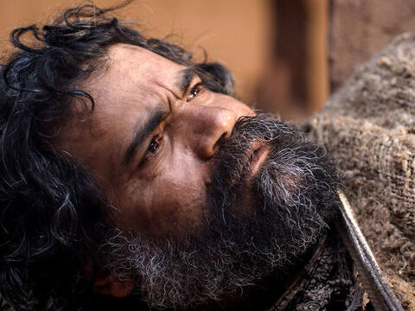
Revealed Glory - John 20:3
Peter therefore went forth, and that other disciple, and came to the sepulchre.

Slide 48
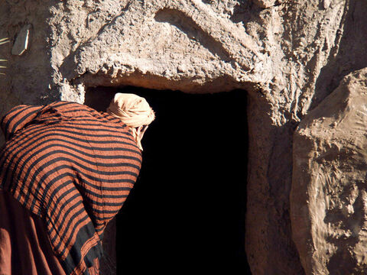
Revealed Glory - John 20:4
So they ran both together: and the other disciple did outrun Peter, and came first to the sepulchre.

Slide 49
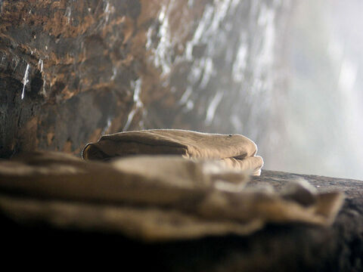
Revealed Glory - John 20:5
And he stooping down, and looking in, saw the linen clothes lying; yet went he not in.

Slide 50
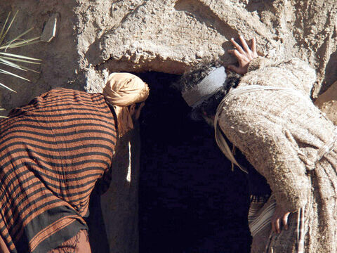
Revealed Glory - John 20:6
Then cometh Simon Peter following him, and went into the sepulchre, and seeth the linen clothes lie,

Slide 51
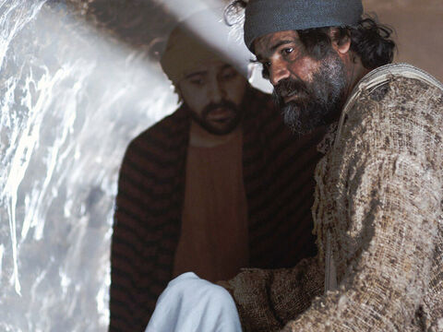
Revealed Glory - John 20:7
And the napkin, that was about his head, not lying with the linen clothes, but wrapped together in a place by itself.

Slide 52
Revealed Glory - John 20:8
Then went in also that other disciple, which came first to the sepulchre, and he saw, and believed.

Slide 53
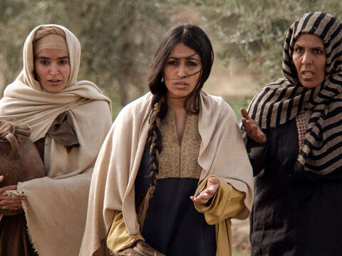
Revealed Glory - John 20:9
For as yet they knew not the scripture, that he must rise again from the dead.

Slide 54
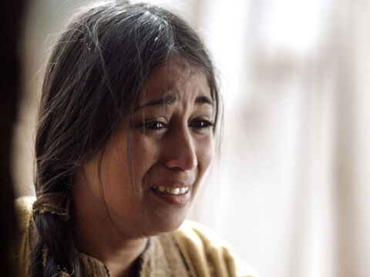
Revealed Glory - John 20:10
Then the disciples went away again unto their own home.

Slide 55
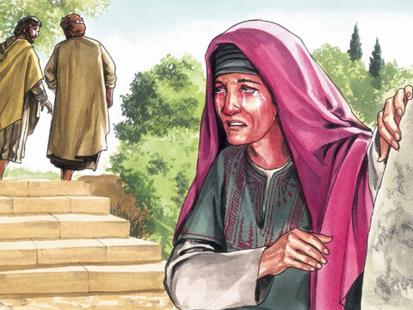
Revealed Glory - John 20:11
But Mary stood without at the sepulchre weeping: and as she wept, she stooped down, and looked into the sepulchre,

Slide 56
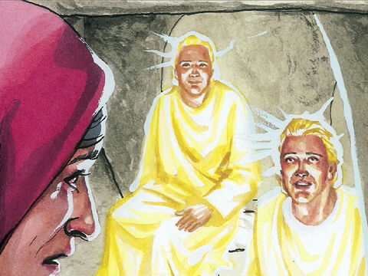
Revealed Glory - John 20:12
And seeth two angels in white sitting, the one at the head, and the other at the feet, where the body of Jesus had lain.

Slide 57
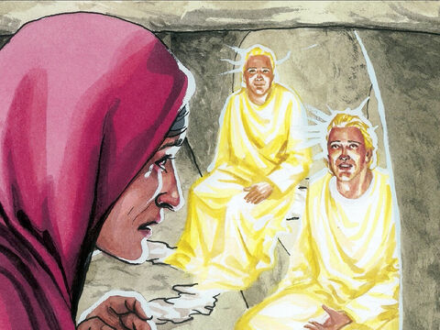
Revealed Glory - John 20:13
And they say unto her, Woman, why weepest thou? She saith unto them, Because they have taken away my Lord, and I know not where they have laid him.

Slide 58
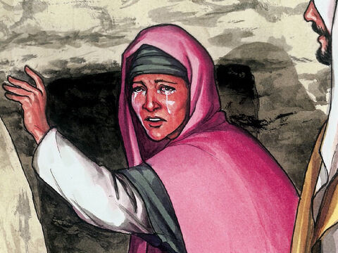
Revealed Glory - John 20:14
And when she had thus said, she turned herself back, and saw Jesus standing, and knew not that it was Jesus.

Slide 59
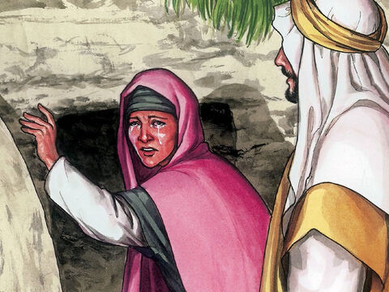
Revealed Glory - John 20:15
Jesus saith unto her, Woman, why weepest thou? whom seekest thou? She, supposing him to be the gardener, saith unto him, Sir, if thou have borne him hence, tell me where thou hast laid him, and I will take him away.

Slide 60
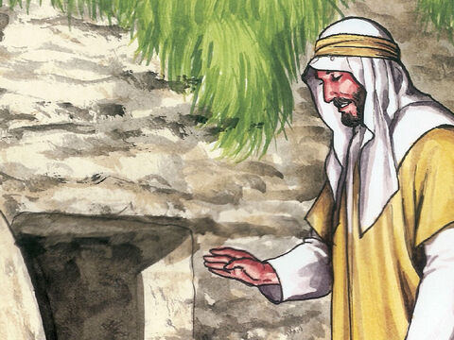
Revealed Glory - John 20:16
Jesus saith unto her, Mary. She turned herself, and saith unto him, Rabboni; which is to say, Master.

Slide 61
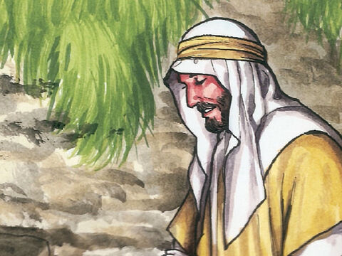
Revealed Glory - John 20:17
Jesus saith unto her, Touch me not; for I am not yet ascended to my Father: but go to my brethren, and say unto them, I ascend unto my Father, and your Father; and to my God, and your God.

Slide 62
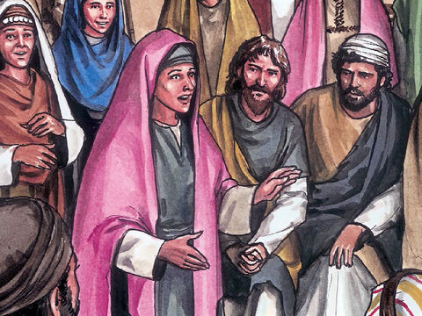
Revealed Glory - John 20:18
Mary Magdalene came and told the disciples that she had seen the Lord, and that he had spoken these things unto her.

Slide 63
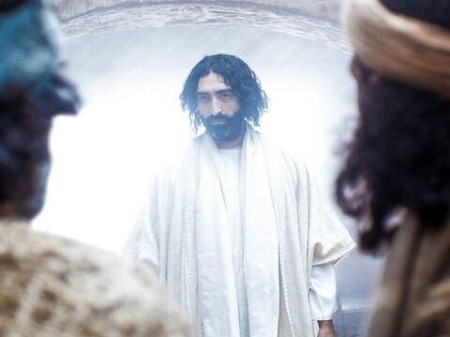
Glory Came Down
John 20:19
Then the same day at evening, being the first day of the week, when the doors were shut where the disciples were assembled for fear of the Jews, came Jesus and stood in the midst, and saith unto them, Peace be unto you.

Slide 64
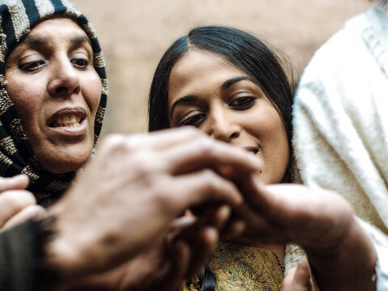
Glory Came Down
John 20:20
And when he had so said, he shewed unto them his hands and his side. Then were the disciples glad, when they saw the Lord.

Slide 65
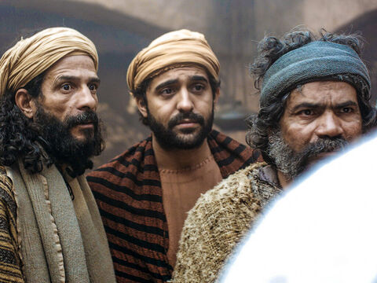
Glory Came Down
John 20:21
Then said Jesus to them again, Peace be unto you: as my Father hath sent me, even so send I you.

Slide 66

Glory Came Down - John 20:22
And when he had said this, he breathed on them, and saith unto them, Receive ye the Holy Ghost:

Slide 67
Happy Sabbath!
Thanks for Joining Us!

